Slide 1

Team s Stage 4
WaitLess
Team Members:
Edmund
Evan
Karan
Robert
Amman
Teaching Assistant:
Philmo Gu
Notes:
Hello and welcome to the Team S Stage 4 presentation. My names Robert McCurdy and I will be doing our presentation today. Along with myself, my team members include Edmund, Evan, Karan, Amman. Our Teaching Assistant for this class is Philmo Gu.

Slide 2
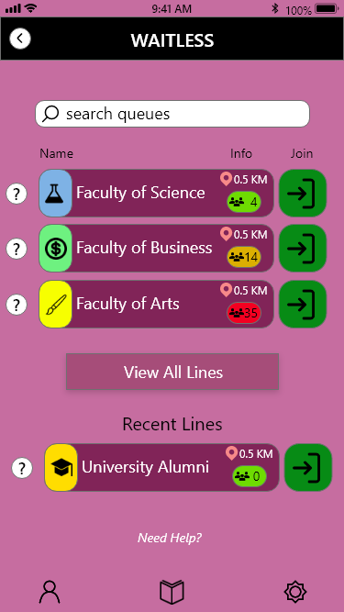
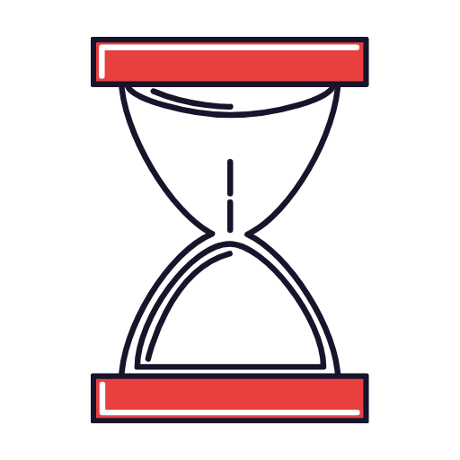
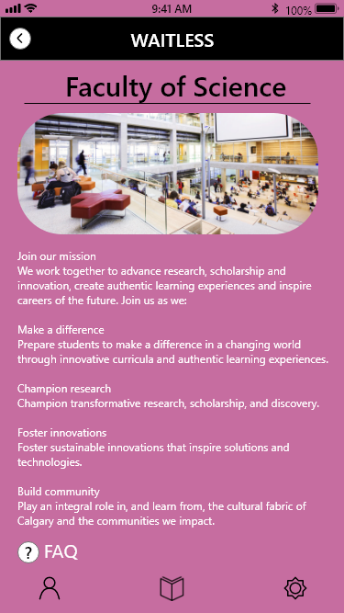
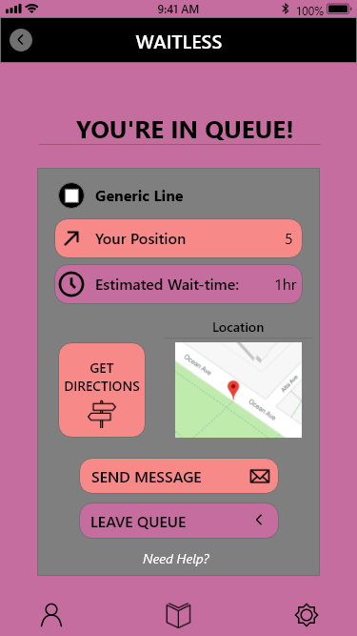
What is waitLESS
Managing and Organizing a Virtual Line
Improve the Virtual Academic Advising Experience for Students
Features to Help and Improve the Process
Take Out the Difficulties and Confusion
Notes:
WaitLess is a mobile app that can manage and organize virtual lines for academic advising. It’s aim is to improve the virtual academic advising experience for students by refining and simplifying a virtual line up system. We went with a mobile application approach as it is the most accessible for students on the go. When they need advising, virtually lining up is as easy as just hitting “Join Line.” While the student waits, they are updated about their placement in line regularly, removing the need for the student to constantly check how long until they are up next. There also includes a chat and FAQ feature that provides the student with quick answers to surface level questions they have. Along with these features, there are many more that we will be covering in our demonstration video. Ultimately, we wanted to take out the difficulties and confusion that new and returning students have with visiting academic advisors, and what better way then with WaitLess.

Slide 3
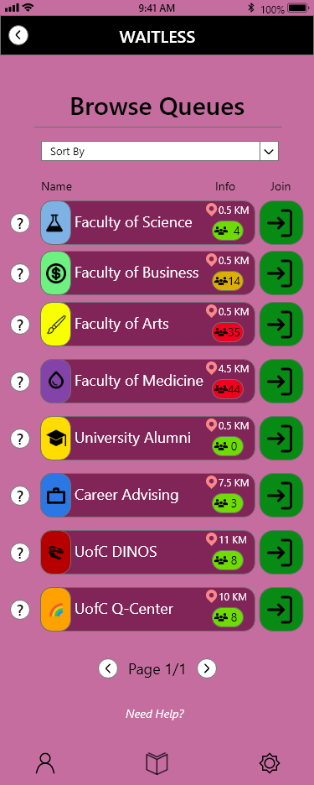
Tasks Prototyped
Search and Browse for Lines/Queues
Notes:
The tasks that we have prototyped in our High Fidelity prototype include firstly searching and browsing for lines. With this, the user is able to either type and search for a specific line they are looking for, or browse for lines that have been sorted into categories. This allows for flexibility for the user, as they have options on how specific or generic they want their searches to be.

Slide 4
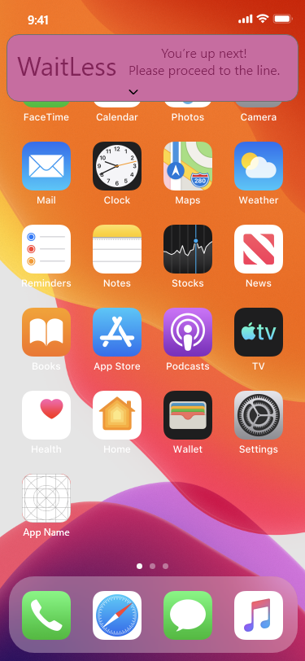
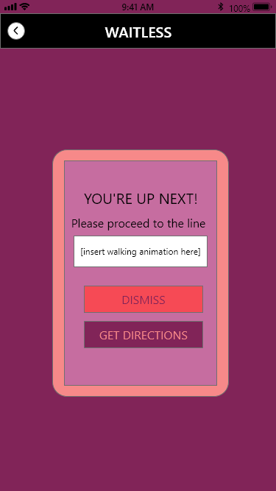
Tasks Prototyped
Notifications to Guide the User
Notes:
Secondly we have notifications. This is a very important task, as it is what prompts the user throughout the queue process. The user becomes notified when they have successfully joined the line, how close they are to the front, and when they are up next. This helps expedite the process with getting people through each line.

Slide 5
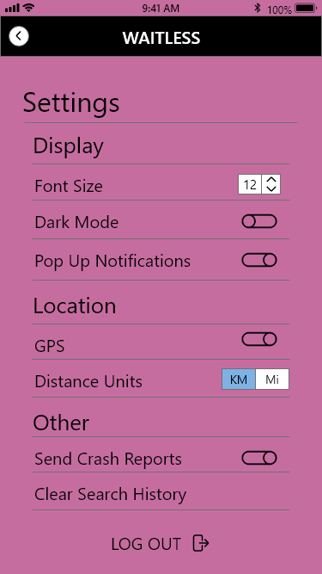
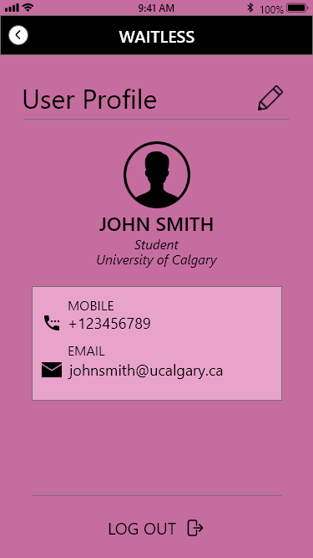
Tasks Prototyped
Modify Settings and Change Profile Information
Notes:
Thirdly, we have modifying the settings and changing profile information. This gives the user freedom to choose how they want to be interacting with the app. Included in the settings, they can disable notifications, change to a dark mode, and change font size. As well, the user can change their information if they have a new email address or phone number.

Slide 6
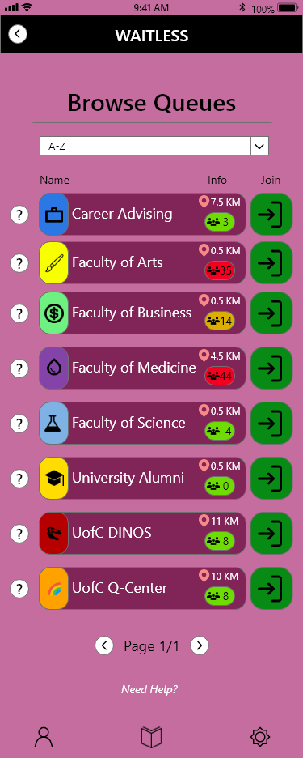
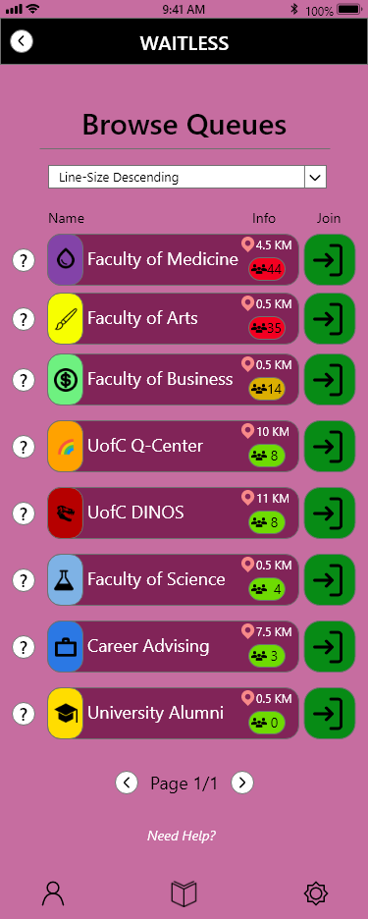
Tasks Prototyped
Sorting of Lines Based on Properties
Notes:
Finally we have sorting the lines. This makes for finding lines you want to join much easier. With this you can sort the lines alphabetically, by distance to the user, and by number of people in the line. With this task, we hope that it leads to better decisiveness for our users when choosing lines to join.

Slide 7

SOFTWARE USED FOR HI-FI Prototype
Notes:
The software that we have chosen and used for our High Fidelity Prototype is Adobe XD. With Adobe XD being a design tool for web apps and mobile apps, we were able to transform our Low Fidelity Prototype into something much more substantial. We agreed as a team to use Adobe XD because of its simplicity in usage and it also had features that would help improve the functionality and design of our prototype.

Slide 8

Demo Video
INSERT VIDEO HERE
Notes:
Here is our Demo Video that illustrates how our app WaitLess functions.

Slide 9

Heuristic Evaluation Process
Notes:
After finishing off the implementations we wanted to add for this Stage of our prototype, we then conducted our heuristic evaluation process. Myself, Evan, and Edmund acted as evaluators along with Amman and Karan acting as reviewers. We were able to determine what we needed to focus and work on for our final product through this process.

Slide 10


Findings & Discussions
Positive Findings & Negative Findings
Notes:
We broke down each of our evaluators thought into two categories, as positive and negative findings. Our positive findings were what us evaluators had unanimously agreed on that we had fully implemented and never violated those rules. Then our negative findings were what we agreed had not been completely violated, but there were areas where improvement was necessary.

Slide 11
Findings & Discussions
Positive Findings
Systems Status Visibility
Information From the Real World
Freedom of Navigation
Flexibility of Use
Notes:
First with the positive findings, this included System Status Visibility which was Sufficient Where Needed especially while in queue, Information From the Real World is Being Used For Location and Directions, Freedom of Navigation which was found throughout the app with Options To Leave the Queue and Go Back, and Few actions are required to completely use our app for the functions it provides.

Slide 12
Findings & Discussions
Negative Findings
Colour and UI Elements
Error Prevention
Recognition Not Utilized Enough
Design of Buttons
Recovery of Errors
Help and Documentation
Notes:
Now with Negative Findings, this included Colour and UI elements not always being consistent such as font and background colour, no error prevention when signing up for an account, No auto complete while searching and Recent Searches from the user are not saved, unlike recent lines joined, vibrant colours are used for specific faculties that clash with the overall purple colour scheme of the app, and Sections in the app don’t include enough help or documentation to give guidance on specifics.

Slide 13
Addressing issues
Most Prevalent Problems
Sign Up Page Errors
Help and Documentation Additions
UI Design Clean Up
Notes:
After going over our findings and having discussions, we have decided on the most prevalent problems to change. These include implementing error prevention in our sign up page, adding more help and documentation in screens that don’t currently have enough, and cleaning up some of the UI Design choices with regards to colours and indications.

Slide 14
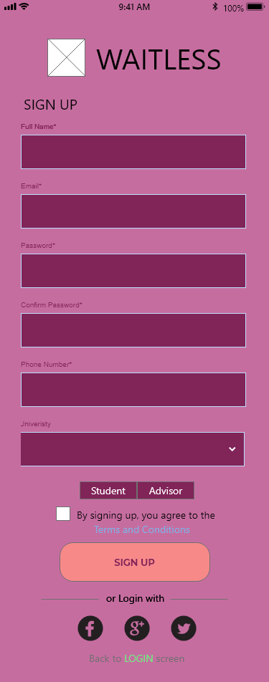
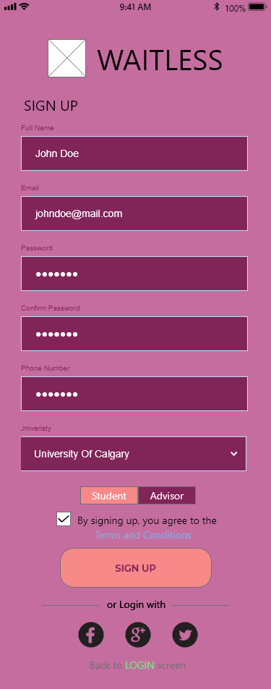
Sign Up page ERROR Prevention
Notes:
Here is what our issue was with providing error prevention specifically in our sign up page. We initially had nothing to stop the user from entering incorrect information, and although we currently haven’t implemented text fields for user input, we at least wanted to create a screen that would stop the user if there was incorrect information. So from the pictures here you can see that the process goes from an unfilled sign up page, to all the fields being filled out, to then the main page.

Slide 15
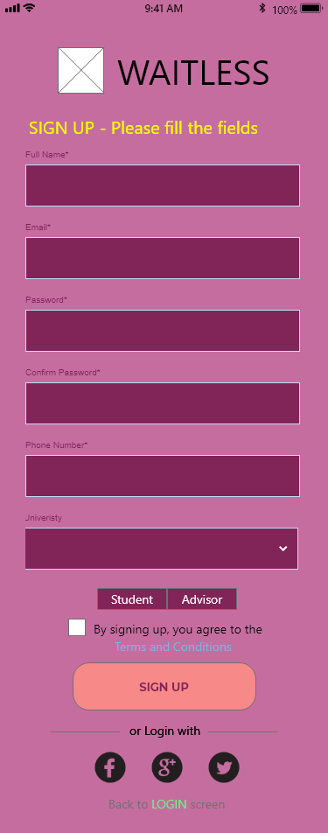
Sign Up page ERROR Prevention
Notes:
With this implementation, we have now created the chance for the system to detect error in the sign up page. With no backend for this prototype, we can at least detect when no fields have been filled in. So this will prevent the user from continuing in the app before filling out all the fields.

Slide 16
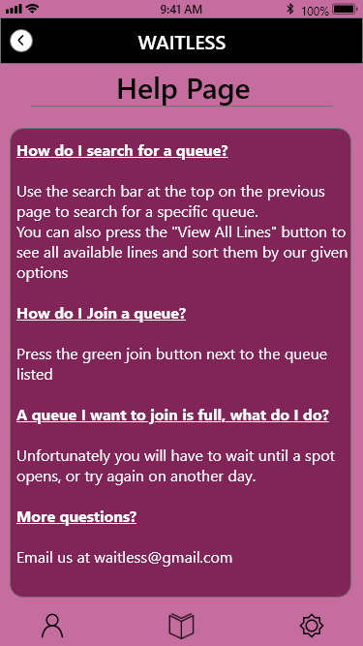
HELP AND DOCUMENTATION ADDITIONS
?
Notes:
Next we have the additional help and documentation where needed. In this example, we have a “Need Help” option at the bottom of the screen. This gives guidance for how to join and search for lines and queues. We felt like it could be better to also have information for each of the lines, as the name might not give away all the details to the user.

Slide 17
HELP AND DOCUMENTATION ADDITIONS
Notes:
So with this implementation we have added a question mark button on the side that takes the user to a page that describes what exactly each line is. This can create for less user error as they won’t mistakenly join the wrong line.

Slide 18
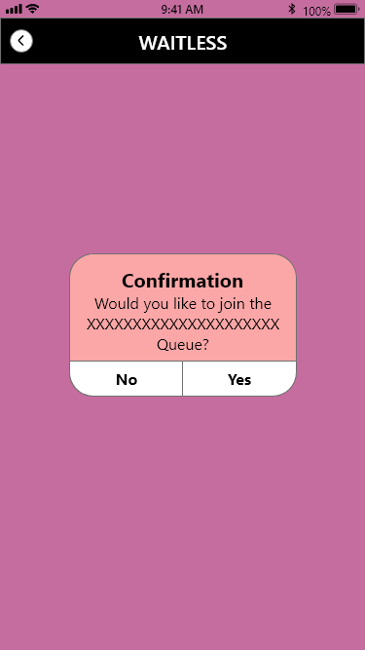
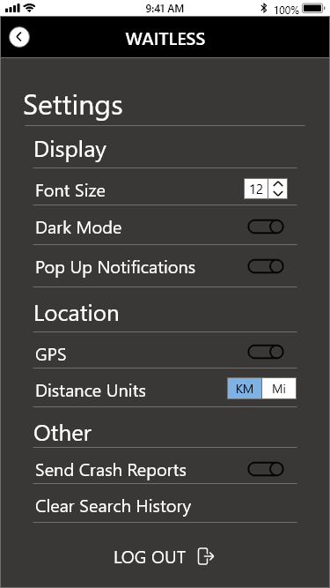
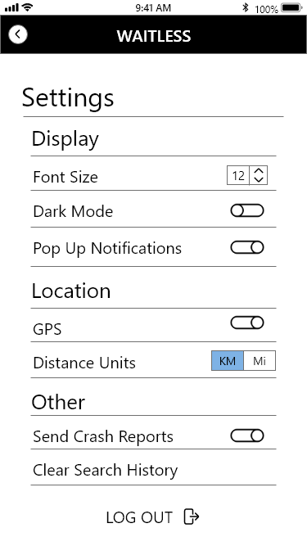
UI DESIGN CLEAN UP
Notes:
Lastly we have cleaning up certain UI Design elements. In the first image we have one of our many confirmation messages. We felt that we could make this message more intuitive by adding colour to give clear indication for the options that the user has. As well we have the settings features in both the dark mode and light mode. With this, we realized this was a screen that didn’t follow our purple colour scheme and we wanted to fix this.

Slide 19
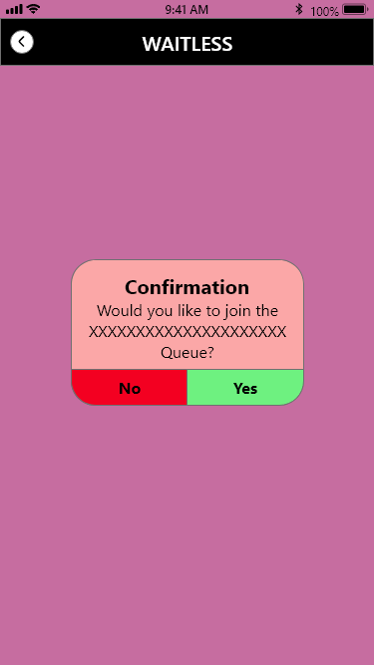
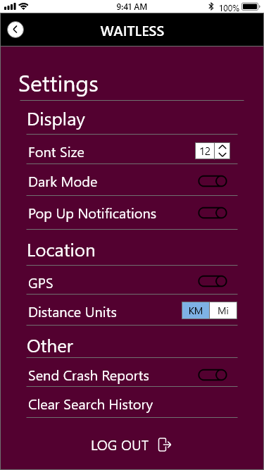

UI DESIGN CLEAN UP
Notes:
So with this implementation, we have coloured the yes and no options green and red respectively. Now it is very clear to the user about what to select. Then we have the settings redesigned to fit our colour scheme. Also we had to go with a darker purple, as black didn’t seem like the right fit for our dark mode.

Slide 20
PLANS FOR FINAL STAGE
Take the Prototype to Mobile
Test our Prototype on Mobile with Different Inputs
Improve Functionality with Buttons
Determining a Final UI Colour Scheme
Notes:
Our first plan for the final stage is to take our prototype to a mobile platform. Currently we have been testing and using our app through a PC emulator. Once we have it on our mobile phones, we may find that some things aren’t sized properly or ease of usability is not ideal. With this, we want to test our prototype against finger pressure input. Through our PC emulator, we are able to get precise input with our mouse, but with finger touching through a mobile device could lead to errors in our prototype. As well, we want to have better functionality when it comes to navigating the app. We have buttons in our prototype that will lead to fixed inputs, but sometimes that is not the best way to go about things. We want to have more dynamic input, just like our back buttons taking the user back to the last screen they came from. This can help reduce the number of screens our prototype needs as well. Finally, we want to determine if the colour scheme we have gone with is what we want to go with. We had been debating changes, and with this final stage we will want to come to a consensus.

Slide 21

Conclusion & Thank you
Portfolio: https://rmccurdy.github.io/TeamS_Project/
Repository: https://github.com/RMcCurdy/TeamS_Project
Notes:
Thank you for listening to our stage 4 presentation. You can learn more about our project with the links on this slide.

